Slide 1


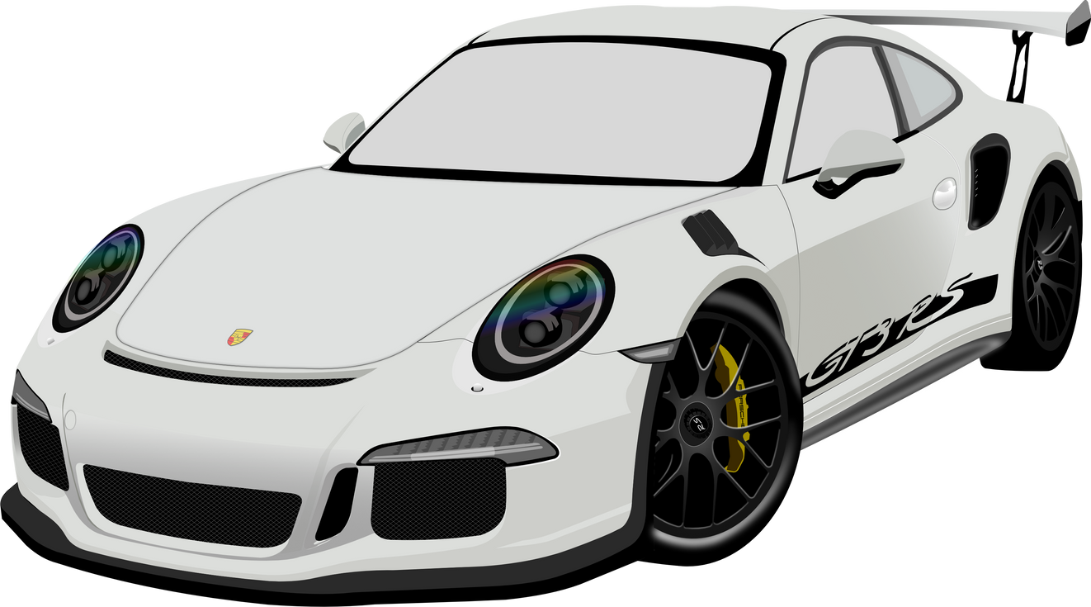

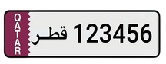
Design and Implementation of a CNN-Based OCR System for License Plate Recognition in Qatar
Group #2
STUDENT NAME
QU ID
Aisha Al-Shahwani
Abir Sidilemine
Samia Hasan
Shaima Nasser
Zobia Zia
202005623
202104894
202105152
202004047
202108274

Slide 2
Contribution of Group Members
Member 1: Aisha Al-Shahwani
Task: Yolov5m.pt, Supervised Learning, Model Evaluation
Member 2: Abir Sidilemine
Task: Image Pre-Processing
Member 3: Samia Hasan
Task: Yolov5, Create the Ground Truth Dataset, Testing & Debugging
Member 4: Shaima Nasser
Task: Setting up the Environment, Detect & Display Objects of Class Car
Member 5: Zobia Zia
Task: Cropping, Apply EasyOCR & Debugging

Slide 3

Problem Definition
The recognition of license plates plays a critical role in traffic management, law enforcement, and parking systems.
However, existing Optical Character Recognition (OCR) systems face significant challenges due to the unique design and structure of Qatari license plates (which contain both Arabic and English text).
Variable lighting conditions, image resolutions, and environmental factors can also cause results that are low in accuracy and reliability.
Therefore, there is a pressing need for an adaptive, high-precision OCR solution tailored specifically to the characteristics of Qatari license plates, enabling efficient and accurate text extraction under diverse conditions.

Slide 4

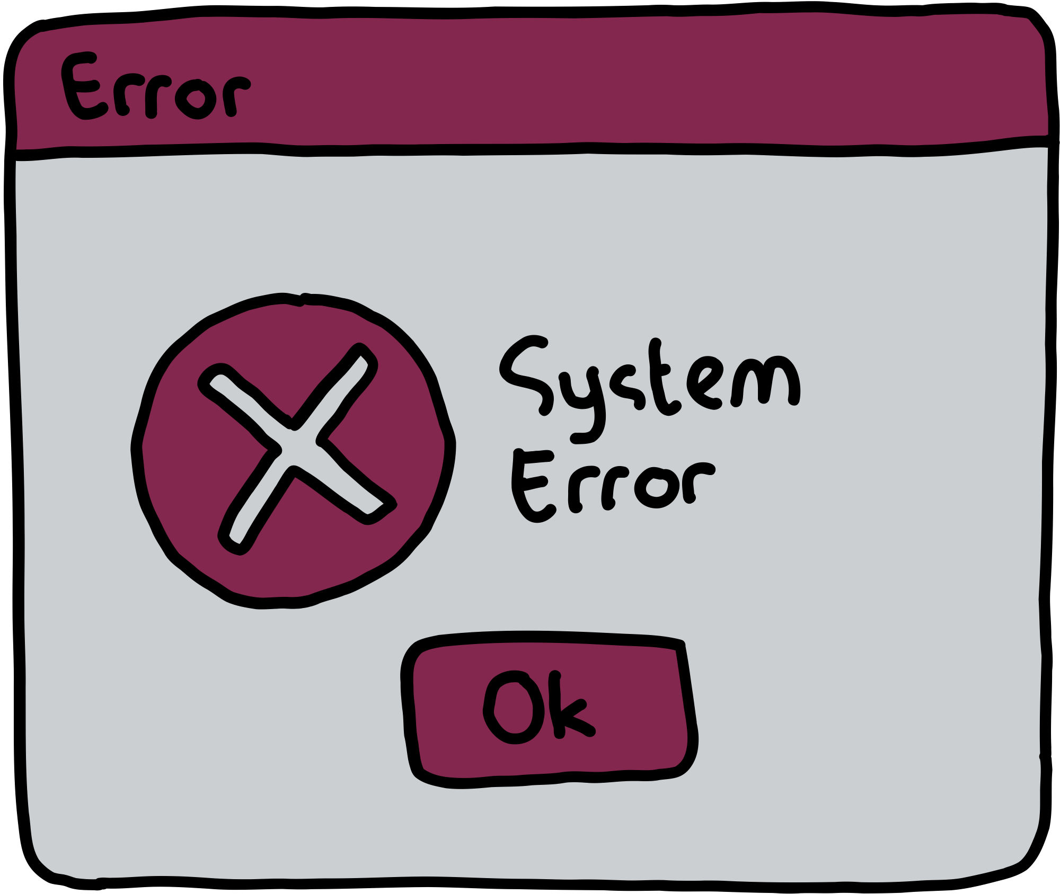
Shortcomings of Existing Methods
Poor accuracy under varying lighting and environmental conditions.
Inability to handle low-resolution or blurry images effectively.
High false positive and false negative rates in object detection.
Lack of optimization for the unique design and layout of Qatari license plates.
Computational inefficiency, making real-time processing challenging.
Dependency on large labeled datasets for training, which may not be readily available for Qatari plates.

Slide 5

How Your Method Resolves These Issues
Built for Qatari Vehicles: We tailored our system to handle the unique features of Qatari Cars and Plates.
Using YOLOv5 for cars: YOLOv5 detects cars in images, and we crop the car using bounding boxes for processing.
Clearer Images for OCR: Steps like blurring, contrast enhancement, and sharpening make the plates easier to read, which increases the accuracy even on low-quality images.
Accurate Performance Metrics: We used accuracy, precision, recall, and F1-score to measure how well the system works.
Smart Error Handling: Any unreadable plates are saved for review, ensuring no data is lost.

Slide 6

Proposed Method
Step 1: Set up the environment.
Step 2: Load the YOLOv5 Model.
Step 3: Load and Display Images.
Step 4: Detect and Annotate Objects in Images Using YOLOv5.
Step 5: Crop the License Plates.
Step 6: Image Pre-processing.
Step 7: Use EasyOCR for Text Recognition.
Step 7: Create carplates.txt.
Step 8: Evaluation Matrix.

Slide 7
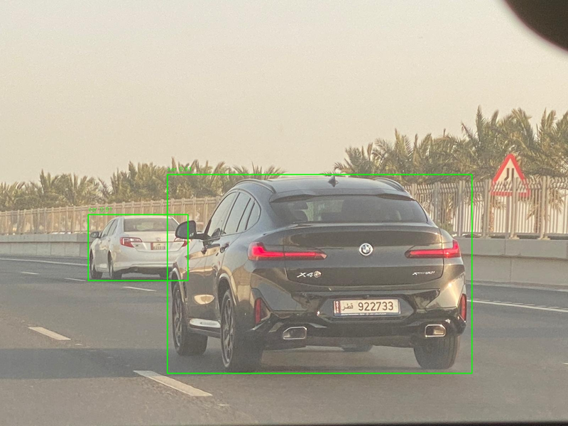
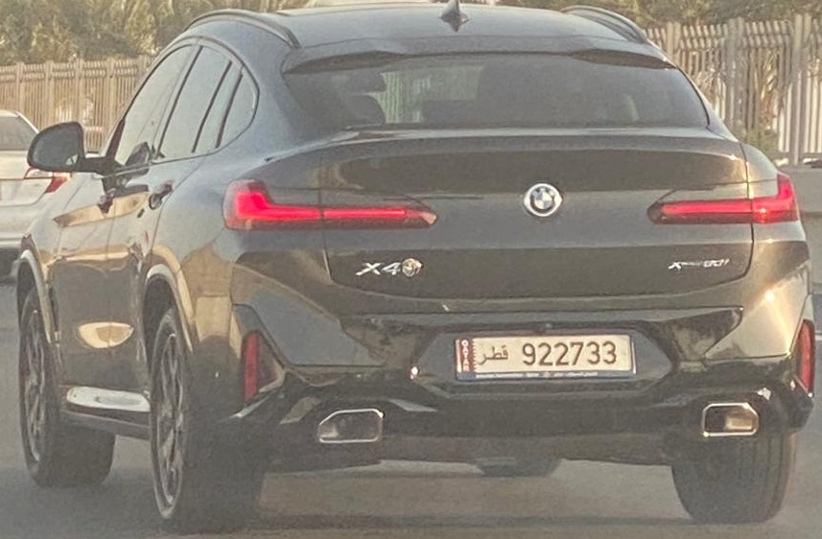
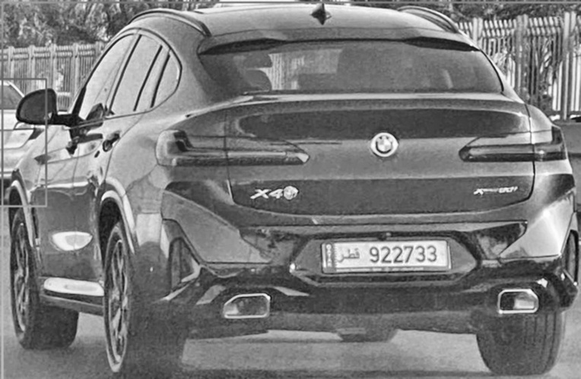
Results Visualization
Object Detection Using YOLOv5m (detected_7.jpg)
Cropped Image of Car Using Bounding Box
(cropped_7.jpg)
Image after Pre-Processing
(cropped_7.jpg)

Slide 8

Results Table
Definitions:
TP (True Positive): Correctly detected and matched license plates.
FP (False Positive): Incorrectly detected plates or mismatched predictions.
FN (False Negative): Plates present but not detected.
TN (True Negative): Correctly ignored cases where no plate was present (not applicable in this dataset).
Performance Metrics:
Precision: 95% - Indicates minimized false positives.
Recall: 92.7% - Highlights ability to detect all plates.
F1-Score: 93.8% - Balances precision and recall.
Accuracy: 88.4% - Reflects overall system performance.

Slide 9

Conclusion
Summary:
Successfully implemented a system for license plate recognition using YOLOv5 and EasyOCR.
Achieved high precision and recall.
Future Work:
Explore advanced preprocessing for challenging conditions.
Expand to handle non-Qatari plates and other scripts.
Challenges:
Most difficult: Handling poor-quality images, creating our own dataset.
Least difficult: Model integration.

Slide 10

Demo and Questions

